Slide 1
Text Books:
1. Computer Science, A Structured Programming Approach using C, B.A. Forouzan and R.F. Gilberg, Third Edition, Thomson.
2. The C Programming Language, B.W. Kernighan, Dennis M.Ritchie, PHI/Pearson Education.
References:
1. Let us C by Yashwanth P. Kanetkar 8th Edition BPB Publications.
2. Understanding Pointers in C by Yashwanth P. Kanetkar.
Notes:
<number>

Slide 2
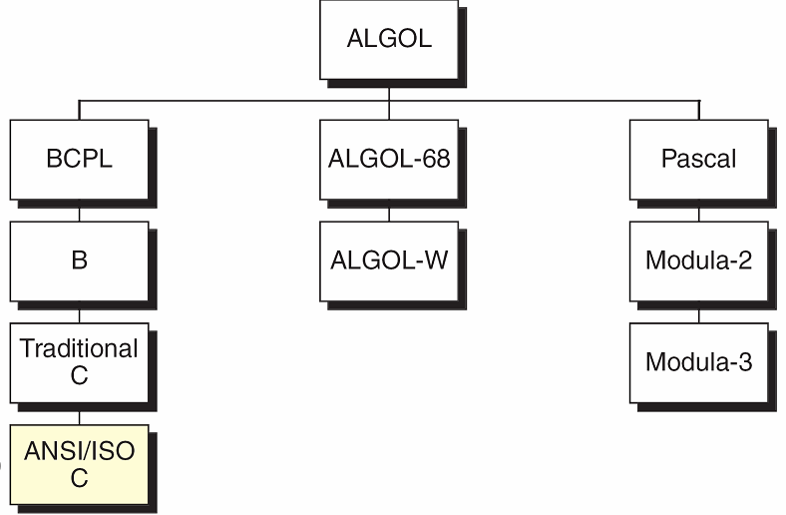
Overview of C
Preceded by BCPL and B
Developed by Dennis Ritchie
Bell Labs in 1972
Used in UNIX, Networks, MySQL, etc...
Taxonomy of the C Language
Notes:
<number>

Slide 3
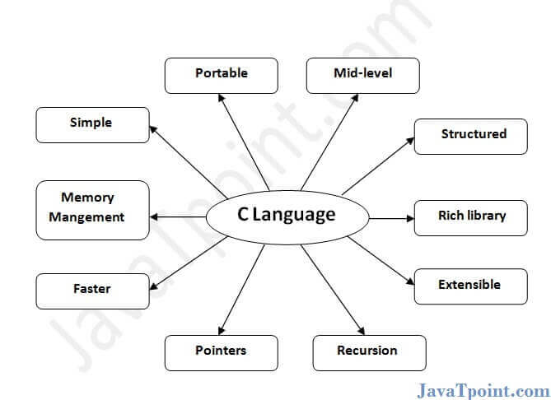
Features of c
1.Simple

Slide 4
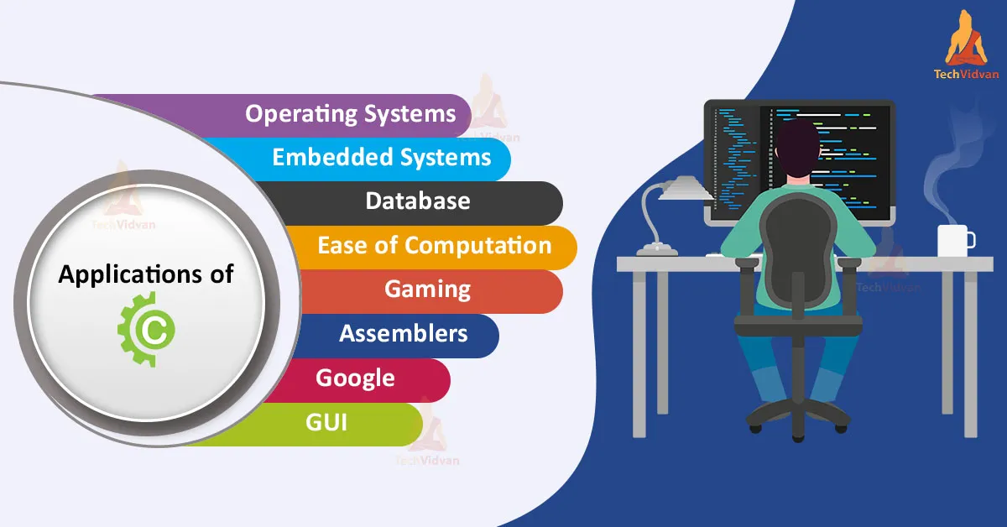

Slide 5
Computer Systems
A computer system consists of hardware and software.
Hardware refers to any physical, electrical components of the computer.
For example keyboard, mouse, monitor, etc. of computer is considered as hardware.
Software refers to a program or set of instructions that is written to achieve a specified task.
Notes:
<number>
<number>

Slide 6
Computer Hardware
Hardware refers to any physical, electrical components of the computer.
The physical equipments required to create, use, manipulate and store the electronic data.
Hardware consist of five parts:
Input Devices, CPU (Central Processing Unit),
Output Devices, Memory, Storage Devices.
Notes:
<number>

Slide 7
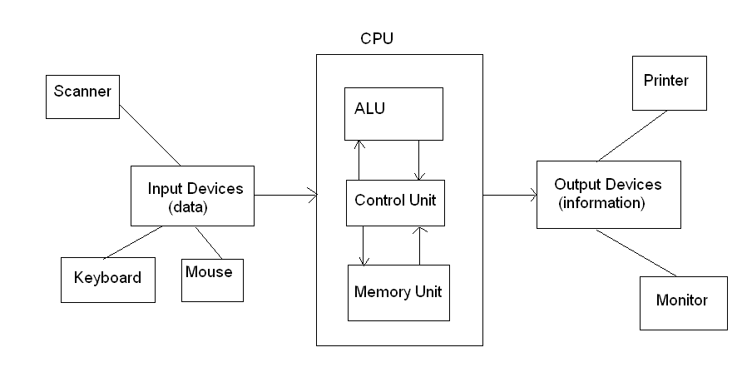
COMPUTER ARCHITECTURE (BLOCK DIAGRAM)
Notes:
<number>

Slide 8
Input Devices:
The input device is used to enter data into a computer.
The devices like keyboard, mouse and scanner are commonly used input devices.
Central Processing Unit:
It is the main part of the computer.
It’s main function is to execute programs stored in the main memory.
It consists of three functional units: ALU, CU and MU.
Arithmetic and Logic Unit (ALU):
It performs arithmetic and logical operations on the data.
Control Unit:
It controls the overall activities of the components of the computer.
Memory Unit:
It is used to hold the waiting data to be processed.
Notes:
<number>

Slide 9
Memory: There are two types of memories.
Volatile Memory
Non-volatile Memory
Volatile Memory: It means that the information present in these types
of memory devices is deleted as soon as the power is switched off.
Non-volatile Memory: It means that the information present in these
types of memory devices is not lost as soon as the power is switched off.
Types of Storage Devices:
Primary Storage or Main Memory.
Auxiliary Storage or Secondary Storage
Cache memory
Registers
Notes:
<number>
<number>

Slide 10
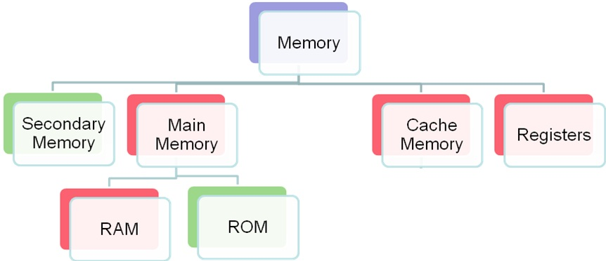
Types of Storage Devices:
Notes:
<number>

Slide 11
Primary Storage/Main Memory:
This is the place where the data is stored temporarily during processing.
Primary memory (main memory) is available in two forms: RAM and ROM.
RAM (Random Access Memory):
It is a temporary storage medium in a computer.
The data which is to be processed by the computer is transferred from a storage device to RAM during data processing.
RAM is a volatile memory.
ROM (Read Only Memory) :
It is a permanent storage medium which stores start up programs.
These programs are loaded when computer is switched on.
ROM is non-volatile memory.
Notes:
<number>

Slide 12
Auxiliary Storage/Secondary Memory:
It is the place where data to be stored permanently. Ex: Disk,tapes.
Cache Memory:
It is a memory placed between CPU and main memory.
It is faster compared to the primary memory.
Parts of the program or data that need to be accessed repeatedly are stored in cache memory.
It is a volatile memory.
Registers:
Registers are small memory units internally available within the
processor.
It is a volatile memory.
Output Devices:
It is used to display or print the result.
Monitor, printer and plotter are commonly used output devices.
If output is shown on the screen it is called soft copy. If it is printed on the paper is called hard copy.
Notes:
<number>

Slide 13
Computer Languages
A program’s instructions need to be written in a programming language that the computer can understand.
The first programming language is machine language.
Computer languages were evolved from machine language to natural language ( like English language).
Computer Languages are basically divided into three categories:
Machine language
Symbolic language
High level languages
Notes:
<number>

Slide 14
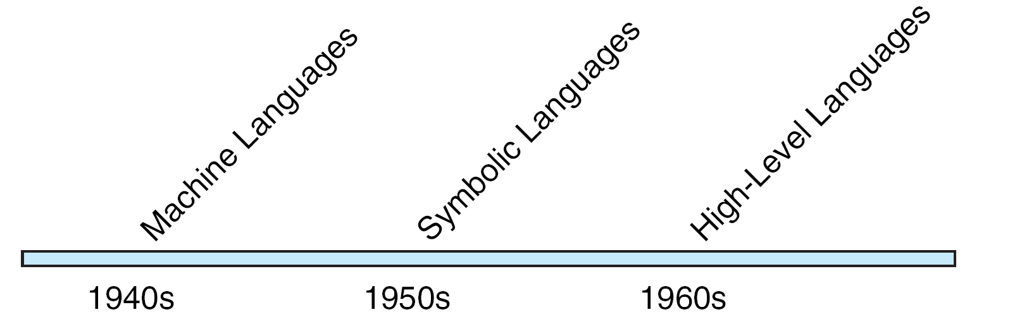
Computer Language Evolution
Notes:
<number>

Slide 15
Machine Language
Machine language was the first programming language in the early days of computers.
The language which is understand by the computer hardware is called machine language.
It consists of 0’s and 1’s.
Internally the computer consists of circuits which are made up of switches, transistors and other electronic devices that can be in one of the two states: off or on, where off is represented by 0 and on is represented by 1.
Notes:
<number>

Slide 16
Symbolic Language
Writing program in machine language is difficult.
The language which is represented using symbols or mnemonics is called as symbolic language.
This language is not understandable by the computer .
Hence, it must be translated to the machine language using the assembler.
Another name of the symbolic language is assembly language.
Notes:
<number>

Slide 17
The Multiplication Program in Symbolic Language
Example for Symbolic Language
Notes:
<number>

Slide 18
High Level Language
It is like natural language which can understandable by the programmer.
The High Level Language instructions are not understandable by the machine.
Compiler is used to convert High Level Language instructions into the Machine Language instructions.
First High Level Language is FORTRAN.
Examples for High Level Languages are : C, C++,JAVA, COBOL etc.,
Notes:
<number>

Slide 19
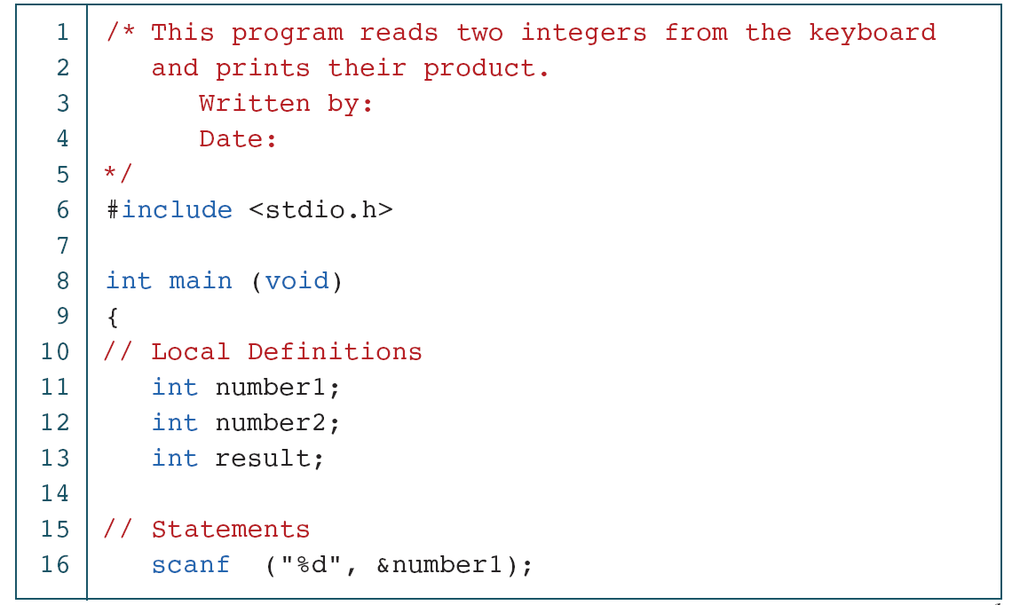
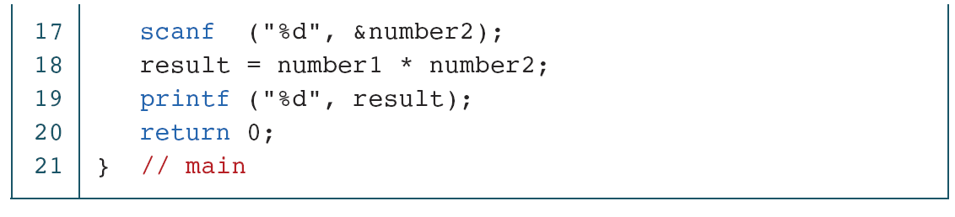
The Multiplication Program in C
Notes:
<number>

Slide 20
Creating and Running Programs
Creating and running programs takes place in 4 steps.
Writing and Editing the program.
Compiling.
Linking the program with the required library functions.
Executing the program.
Notes:
<number>

Slide 21
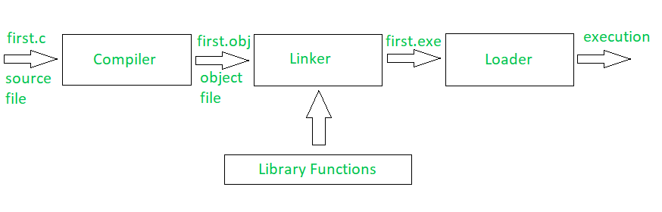
Building a C Program
Notes:
<number>

Slide 22
1. Writing and Editing the program
Software used to write programs is known as a text editor, where you can type, edit and store the data.
You can write a C program in text editor and save that file on to the disk with “.c” extension. This file is called source file.
Notes:
<number>

Slide 23
2. Compiling Program
Compiler is used to convert High Level Language instructions into the Machine Language instructions.
It could complete its task in two steps.
i) Preprocessor
ii) Translator
Preprocessor:
It reads the source file and checks for special commands known as preprocessor commands ( instructions which starts with # symbols ).
The result of preprocessor is called as translation unit.
Preprocessor processes the source file before compilation only.
Translator:
It is a program which reads the translation unit and converts the program into machine language and gives the object module.
This module is not yet ready to run because it does not have the required C functions included.
Notes:
<number>

Slide 24
3. Linking a program with required library functions
C program is made up of different functions in which some functions can be written by the programmer, other functions like input/output functions and mathematical functions, that exist elsewhere and must be attached to our program.
The linker assembles all of these functions and produces the executable file which is ready to run on the computer.
4. Executing the program.
Once a program has been linked, it is ready for execution.
Now, you can execute the program by using the run command.
Loader is a program which is used to load the program from the disk to main memory.
Notes:
<number>

Slide 25
Algorithm
Algorithm: It is an ordered sequence of instructions are designed to perform some task and halts in finite time
Let's examine the four parts of this definition more closely.
Ordered Sequence: You can number the step.
Unambiguous and well defined instructions: Each instruction should be clear, understandable without any difficulty.
Performs some task
Halts in finite time: Algorithm must terminate at some point.
Notes:
<number>
c
<number>

Slide 26
Properties of an Algorithm:-
Finiteness: An algorithm must terminate in a finite number of steps.
Definiteness: Each step of an algorithm must be precisely and
unambiguously stated.
Generality: The algorithm must be complete in itself.
Input/Output: Each algorithm must take zero, one or more inputs and produces one or more output.
Notes:
<number>
<number>

Slide 27
Pseudo Code
Definition: it is a informal highlevel representaion of actual code.
It shows how an algorithm or program works.
Example1: To determine whether a student is passed or not
Algorithm:
1. If student's grade is greater than or equal to 60
1.1 Print "passed"
2. else
2.1 Print "failed"
Pseudo Code:
Begin
1. If(grade >= 60)
1.1 Print "passed"
2. else
2.1 Print "failed”
3. endif
End
Notes:
<number>

Slide 28
Example 2: Write an algorithm to determine a student’s final grade
and indicate whether it is passing or failing. The final grade is calculated
as the average of four marks.
Algorithm:
1. Input set of 4 marks
2. Calculate their average by summing and dividing by 4
3. if average is below 50
4. Print “FAIL”
5. else
6. Print “PASS”
Pseudo Code:
Begin
Step 1: Input M1,M2,M3,M4
Step 2: GRADE ← (M1+M2+M3+M4)/4
Step 3: if (GRADE < 50) then
Step 4: Print “FAIL”
Step 5: else
Step 6: Print “PASS”
Step 7: endif
End
Notes:
<number>

Slide 29
Flowchart
Pictorial representation of an algorithm is called flowchart.
or
A diagram that uses graphic symbols to depict the nature and flow of the steps in a process.
Notes:
<number>

Slide 30
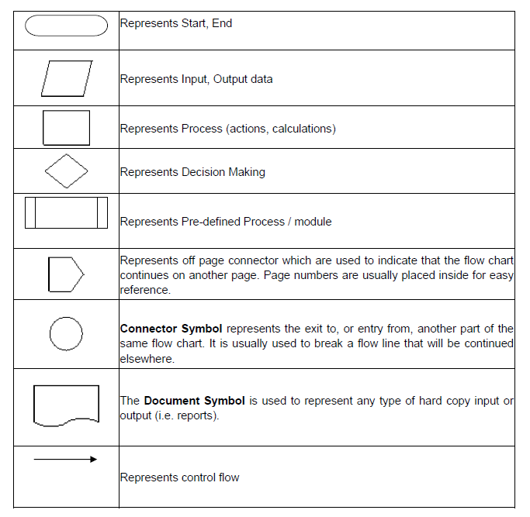
SYMBOLS USED WITH FLOWCHARTS
Notes:
<number>
<number>
<number>

Slide 31
Flowchart to find the addition of two numbers
Start
Accept a, b
c = a + b
Display C
End
Notes:
<number>

Slide 32
Pseudo Code : find whether a given number is even or not
Pseudo Code:
1.READ number
2.remainder=number%2
3.IF remainder==0
WRITE "Even Number"
4.ELSE
5. WRITE "Odd Number"
6.ENDIF
Notes:
<number>

Slide 33
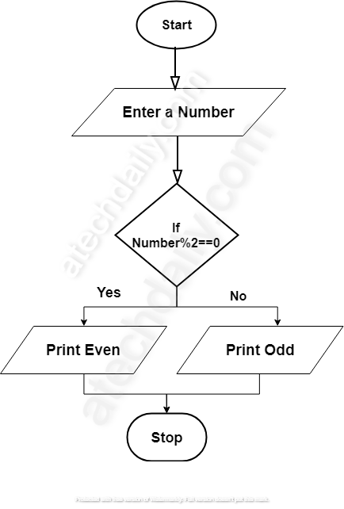
Flowchart to find whether a given number is even or not

Slide 34
Exercise:
1. Sum of the digits of a number.
2. Nature of quadratic equations
3.calculate the simple interest
Notes:
<number>

